Slide 1

Chapter 2:
The Project Management and Information Technology Context
Information Technology Project Management, Seventh Edition
Note: See the text itself for full citations.

Slide 2
Projects Cannot Be Run
In Isolation
Projects must operate in a broad organizational environment
Project managers need to use systems thinking:
  taking a holistic view of carrying out projects within the context of the organization
Senior managers must make sure projects continue to support current business needs

Slide 3
A Systems View of Project Management
A systems approach emerged in the 1950s to describe a more analytical approach to management and problem solving
Three parts include:
  Systems philosophy: an overall model for thinking about things as systems
  Systems analysis: problem-solving approach
  Systems management: address business, technological, and organizational issues before making changes to systems

Slide 4
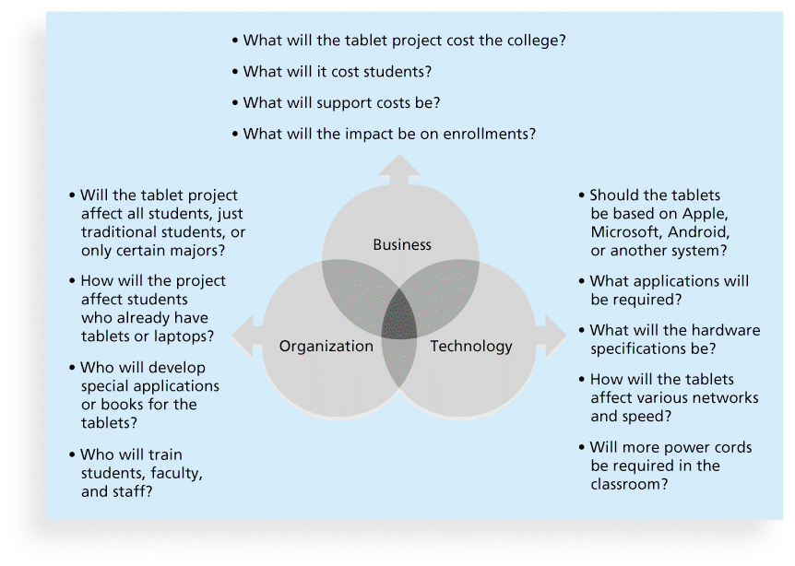
Figure 2-1. Three Sphere Model for Systems Management

Slide 5
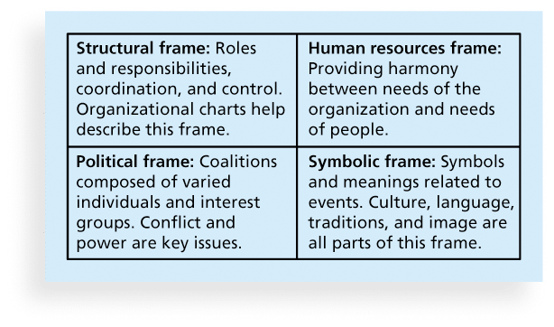
Figure 2-2. Perspectives on Organizations

Slide 6
Organizational Structures
3 basic organization structures
  Functional: functional managers report to the CEO
  Project: program managers report to the CEO
  Matrix: middle ground between functional and project structures; personnel often report to two or more bosses; structure can be weak, balanced, or strong matrix

Slide 7
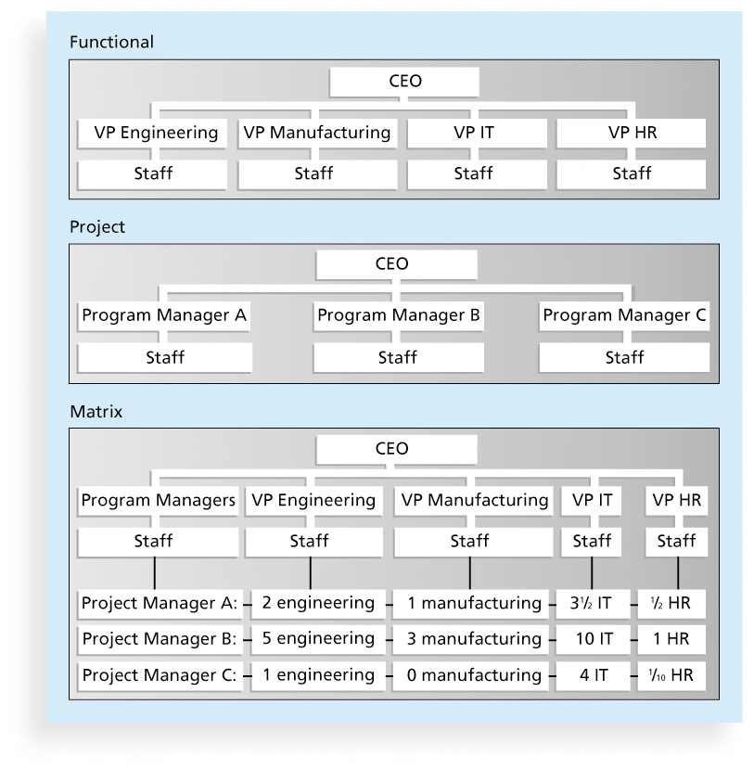
Figure 2-3. Functional, Project, and Matrix Organizational Structures

Slide 8
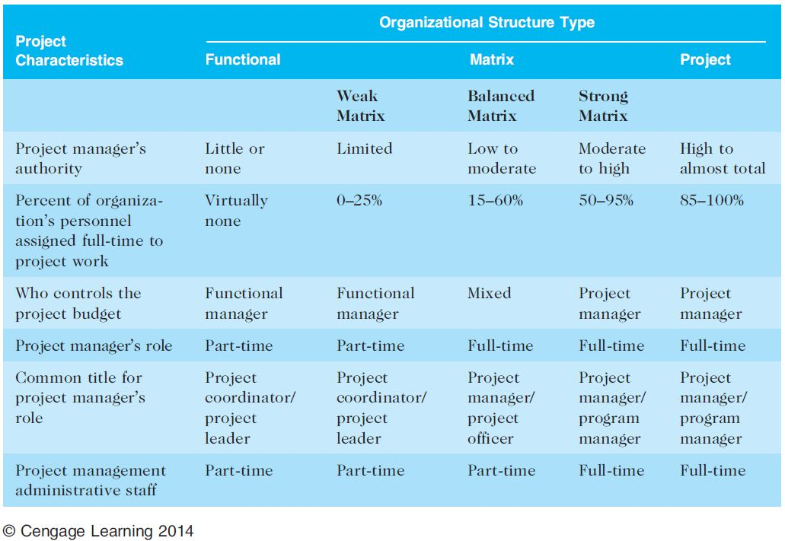
Table 2-1. Organizational Structure Influences on Projects

Slide 9
Organizational Culture
Organizational culture is a set of shared assumptions, values, and behaviors that characterize the functioning of an organization
Many experts believe the underlying causes of many companies’ problems are not the structure or staff, but the culture

Slide 10
Ten Characteristics of Organizational Culture
Member identity*
Group emphasis*
People focus
Unit integration*
Control
Risk tolerance*
Reward criteria*
Conflict tolerance*
Means-ends orientation
Open-systems focus*
*Project work is most successful in an organizational culture where these items are strong/high and other items are balanced.

Slide 11
Stakeholder Management
Project managers must take time to identify, understand, and manage relationships with all project stakeholders
Using the four frames of organizations can help meet stakeholder needs and expectations
Senior executives/top management are very important stakeholders
See Chapter 13, Project Stakeholder Management, for more information

Slide 12
The Importance of Top Management Commitment
People in top management positions are key stakeholders in projects
A very important factor in helping project managers successfully lead projects is the level of commitment and support they receive from top management
Without top management commitment, many projects will fail.
Some projects have a senior manager called a champion who acts as a key proponent for a project.

Slide 13
Project Phases and the Project Life Cycle
A project life cycle is a collection of project phases that defines
  what work will be performed in each phase
  what deliverables will be produced and when
  who is involved in each phase, and
  how management will control and approve work produced in each phase
A deliverable is a product or service produced or provided as part of a project

Slide 14
More on Project Phases
In early phases of a project life cycle
  resource needs are usually lowest
  the level of uncertainty (risk) is highest
  project stakeholders have the greatest opportunity to influence the project
In middle phases of a project life cycle
  the certainty of completing a project improves
  more resources are needed
The final phase of a project life cycle focuses on
  ensuring that project requirements were met
  the sponsor approves completion of the project

Slide 15
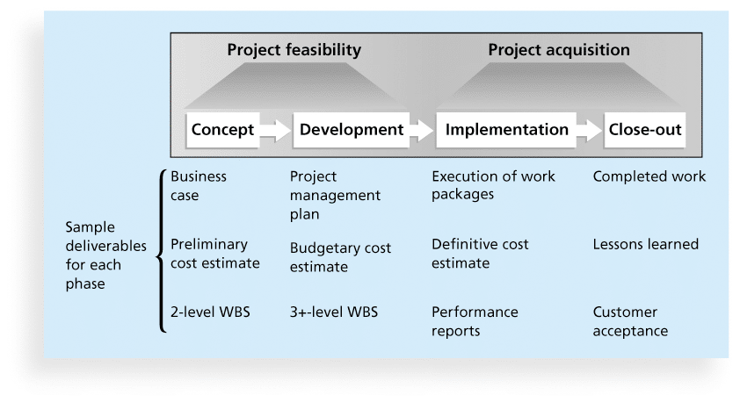
Figure 2-4. Phases of the Traditional Project Life Cycle

Slide 16
Product Life Cycles
Products also have life cycles
The Systems Development Life Cycle (SDLC) is a framework for describing the phases involved in developing and maintaining information systems
Systems development projects can follow
  Predictive life cycle: the scope of the project can be clearly articulated and the schedule and cost can be predicted
  Adaptive Software Development (ASD) life cycle: requirements cannot be clearly expressed, projects are mission driven and component based, using time-based cycles to meet target dates

Slide 17
Predictive Life Cycle Models
Waterfall model: has well-defined, linear stages of systems development and support
Spiral model: shows that software is developed using an iterative or spiral approach rather than a linear approach
Incremental build model: provides for progressive development of operational software
Prototyping model: used for developing prototypes to clarify user requirements
Rapid Application Development (RAD) model: used to produce systems quickly without sacrificing quality

Slide 18
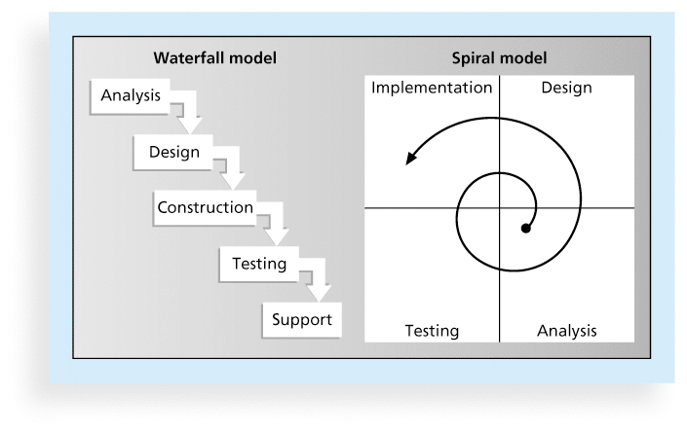
Figure 2-5. Waterfall and Spiral Life Cycle Models

Slide 19
The Importance of Project Phases and Management Reviews
A project should successfully pass through each of the project phases in order to continue on to the next
Management reviews, also called phase exits or kill points, should occur after each phase to evaluate the project’s progress, likely success, and continued compatibility with organizational goals

Slide 20
The Context of IT Projects
IT projects can be very diverse in terms of size, complexity, products produced, application area, and resource requirements
IT project team members often have diverse backgrounds and skill sets
IT projects use diverse technologies that change rapidly. Even within one technology area, people must be highly specialized

Slide 21
Outsourcing
Organizations remain competitive by using outsourcing to their advantage, such as finding ways to reduce costs
Their next challenge is to make strategic IT investments with outsourcing by improving their enterprise architecture to ensure that IT infrastructure and business processes are integrated and standardized (See Suggested Readings)
Project managers should become more familiar with negotiating contracts and other outsourcing issues

Slide 22
Global Issues
Outsourcing also has disadvantages. For example, Apple benefits from manufacturing products in China, but it had big problems there after its iPhone 4S launch in January 2012 caused fighting between migrant workers who were hired by scalpers to stand in line to buy the phones.
When Apple said it would not open its store in Beijing, riots resulted and people attacked security guards. The Beijing Apple Store has had problems before. In May 2011, four people were injured when a crowd waiting to buy the iPad 2 turned ugly.

Slide 23
Virtual Teams Advantages
Increasing competiveness and responsiveness by having a team of workers available 24/7
Lowering costs because many virtual workers do not require office space or support beyond their home offices.
Providing more expertise and flexibility by having team members from across the globe working any time of day or night
Increasing the work/life balance for team members by eliminating fixed office hours and the need to travel to work.

Slide 24
Virtual Team Disadvantages
Isolating team members
Increasing the potential for communications problems
Reducing the ability for team members to network and transfer information informally
Increasing the dependence on technology to accomplish work
See text for a list of factors that help virtual teams succeed, including team processes, trust/relationships, leadership style, and team member selection

Slide 25
Agile Project Management
Agile means being able to move quickly and easily, but some people feel that project management, as they have seen it used, does not allow people to work quickly or easily.
Early software development projects often used a waterfall approach, as defined earlier in this chapter. As technology and businesses became more complex, the approach was often difficult to use because requirements were unknown or continuously changing.
Agile today means using a method based on iterative and incremental development, in which requirements and solutions evolve through collaboration.

Slide 26
Scrum
According to the Scrum Alliance, Scrum is the leading agile development method for completing projects with a complex, innovative scope of work.
The term was coined in 1986 in a Harvard Business Review study that compared high-performing, cross-functional teams to the scrum formation used by rugby teams.

Slide 27
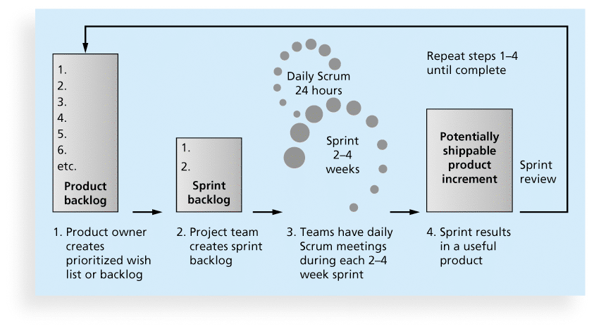
Figure 2-6. Scrum Framework

Slide 28
Agile, the PMBOK® Guide, and a New Certification
The PMBOK® Guide describes best practices for what should be done to manage projects.
Agile is a methodology that describes how to manage projects.
The Project Management Institute (PMI) recognized the increased interest in Agile, and introduced a new certification in 2011 called Agile Certified Practitioner (ACP).
Seasoned project managers understand that they have always had the option of customizing how they run projects, but that project management is not easy, even when using Agile.

Slide 29
Chapter Summary
Project managers need to take a systems approach when working on projects
Organizations have four different frames: structural, human resources, political, and symbolic
The structure and culture of an organization have strong implications for project managers
Projects should successfully pass through each phase of the project life cycle
Project managers need to consider several factors due to the unique context of information technology projects
Recent trends affecting IT project management include globalization, outsourcing, virtual teams, and Agile

